Slide 1
Solar debrief
May 11, 2015

Slide 2
Overview
Net metering basics and cap status
Review of Net Metering and Solar Task Force (TF) Report
Beacon Hill politics and timeline
What you can do
Bonus: Responding to utility talking points

Slide 3
Net Metering Cap Status

Slide 4
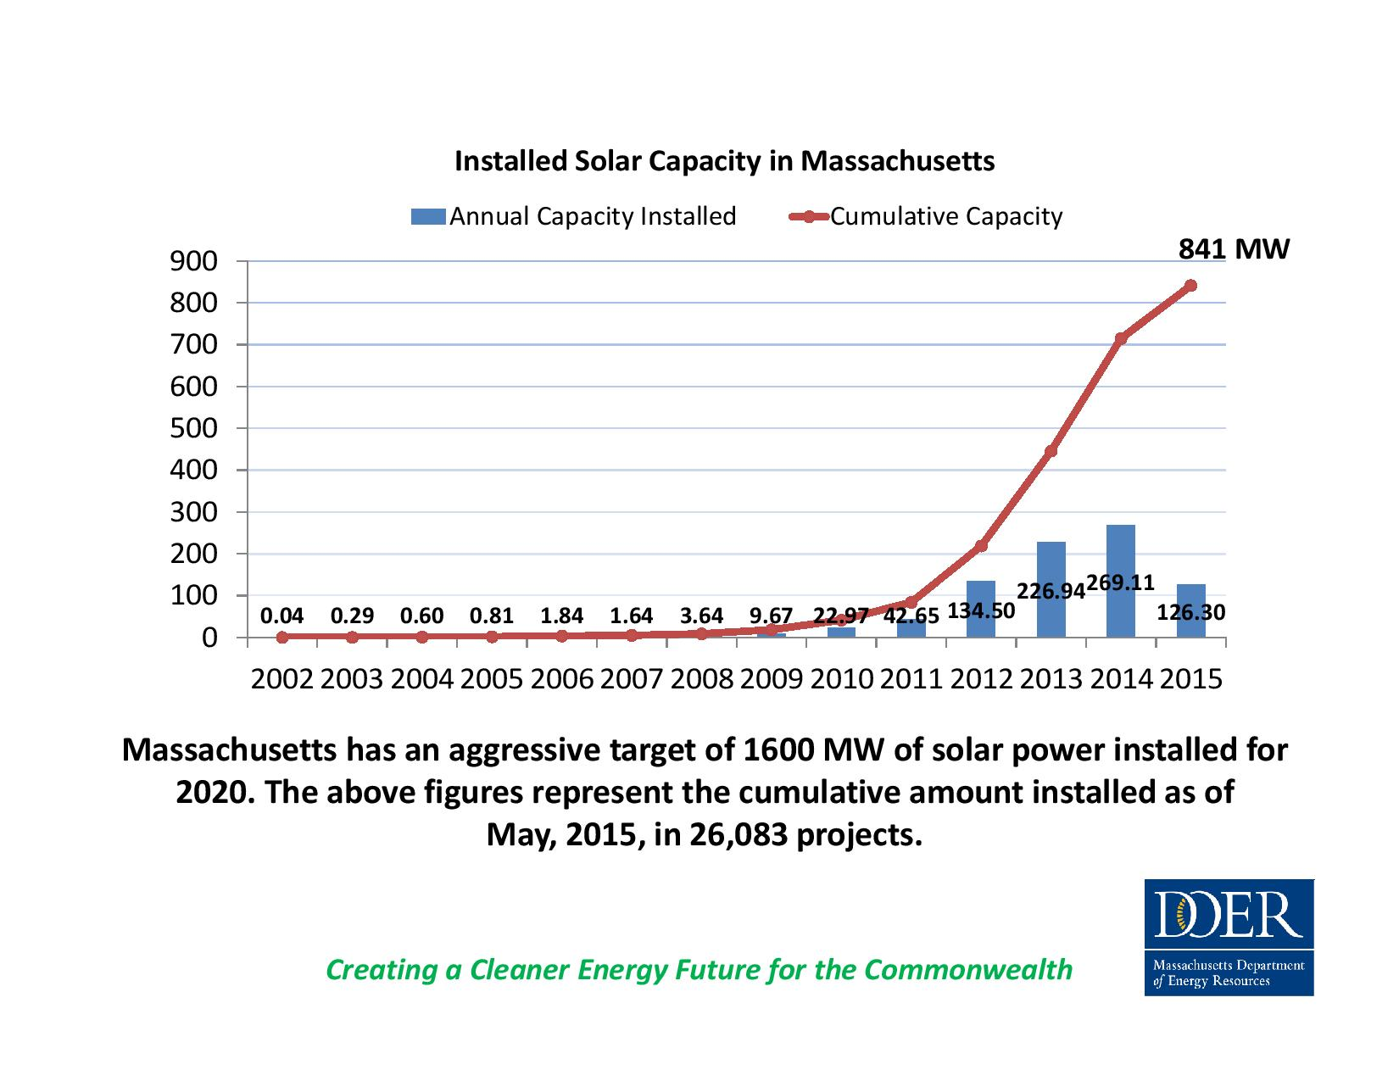
Solar snapshot
841 MW installed
Solar generates 2% of electricity consumed
Produces enough to power 128,000 homes
MA 2nd largest solar employer in the nation
Technical potential of solar can generate 2x the power MA consumes

Slide 5
Key solar policies
Solar projects in Massachusetts receive payment from two programs:
1. Net metering
Administered by the Department of Public Utilities
Allows solar to run the meter backwards and share net metering credits; virtual net metering allows 80% of residents and businesses without sunny rooftops to directly access solar
Solar projects credited for the electricity exported to the grid on a per kWh basis. NOT an incentive!
2. Incentive: Solar Renewable Energy Certificate Program (SREC II)
A production-based incentive program administered by the Department of Energy Regulations designed to manage the growth solar to 1600 MW
Incentive designed to compensate projects for environmental benefits and encourage certain project types, e.g. community shared solar, low income solar and parking canopies, preferred over others through differential SREC factors

Slide 6
Net metering cap basics
Net metering caps are set by statute, M.G.L. c. 164 s. 139
Each utility has two net metering caps, one for “public” projects and one for “private” projects
For each utility, net metering caps currently at 5% of peak demand for public projects and 4% of peak demand for private projects or about 1000 MW statewide
The Legislature has enacted new net metering laws in 2008, 2010, 2012, and 2014
Net metering cap is not aligned with the 1600 MW solar target
NOTE: Small residential and commercial projects exempt from net metering caps
Massachusetts Assurance of Net Metering eligibility (Mass ACA) tracks net metering applications, allocations and waiting lists
Notes:
Net metering cap exemption for small projects: “A Class I net metering facility shall be exempt from the aggregate net metering capacity of facilities that are not net metering facilities of a municipality or other governmental entity under subsection (f), and may net meter if it is generating renewable energy and the nameplate capacity of the facility is (1) equal to or less than 10 kilowatts on a single-phase circuit or (2) 25 kilowatts on a 3-phase circuit.”

Slide 7
Status of net metering caps
Click here.

Slide 8
Why hitting the caps is bad
Net metering cap hit in National Grid early March
National Grid caps limit access to solar in 171 communities
Community shared, low income, municipal and other projects stalled until legislature acts
A portion of the 12,000 solar jobs are at risk
Missed opportunity to leverage 30% federal Investment Tax Credit before it expires at end of 2016

Slide 9
Net Metering and Solar Task Force Report

Slide 10
Net Metering and Solar Task Force
How did we get here?
Outcome of failed attempt to pass H. 4185 in 2014
Task Force scope, per enabling legislation:
“[A]ssess and report to the legislature on the costs and benefits of the existing net metering framework from the perspectives of the customer-generator, non-participating ratepayers and the citizens of the commonwealth at large…review incentive programs offered in other states…and … include in its findings an analysis on the impact of a minimum bill, paid by all ratepayers in all rate classes, as a mechanism to support a reliable electric distribution system.”

Slide 11
Task Force Members
Dan Burgess, DOER Commissioner; Task Force Co-Chair
Angie O'Connor, DPU Chair; Task Force Co-Chair
Benjamin B. Downing, Senator
Brian S. Dempsey, Representative
Eric J. Krathwohl, Rich May, P.C., Republican appointee
Liam Holland, Republican appointee
Paul Brennan, Attorney General’s Office
David Colton, Easton Town Administrator
Robert Rio, Associated Industries of Massachusetts
Charles Harak, National Consumer Law Center
William Stillinger, SEBANE
Fred Zalcman, SunEdison and Solar Energy Industries Association
Janet Besser, New England Clean Energy Council
Geoff Chapin, Next Step Living
Lisa Podgurski, International Brotherhood of Electrical Workers Local 103
Camilo Serna, Eversource
Amy Rabinowitz, National Grid

Slide 12
Task Force Report
Final report about 400 pages, 24 MB
Available here.
Includes policy recommendations, individual statements, consultant reports, stakeholder interviews, model assumptions, utility data requests and responses, PPT presentations, etc.

Slide 13
Consultant Reports and Analysis
Consultant team given six separate tasks:
Interview TF Members and other stakeholders
Review solar incentive programs in other states
Review development of solar in states without solar incentives
Analyze cost and benefits of solar policies in MA
Model cost and benefits of policy options to get to 1600 MW and beyond
Minimum bill survey and analysis

Slide 14
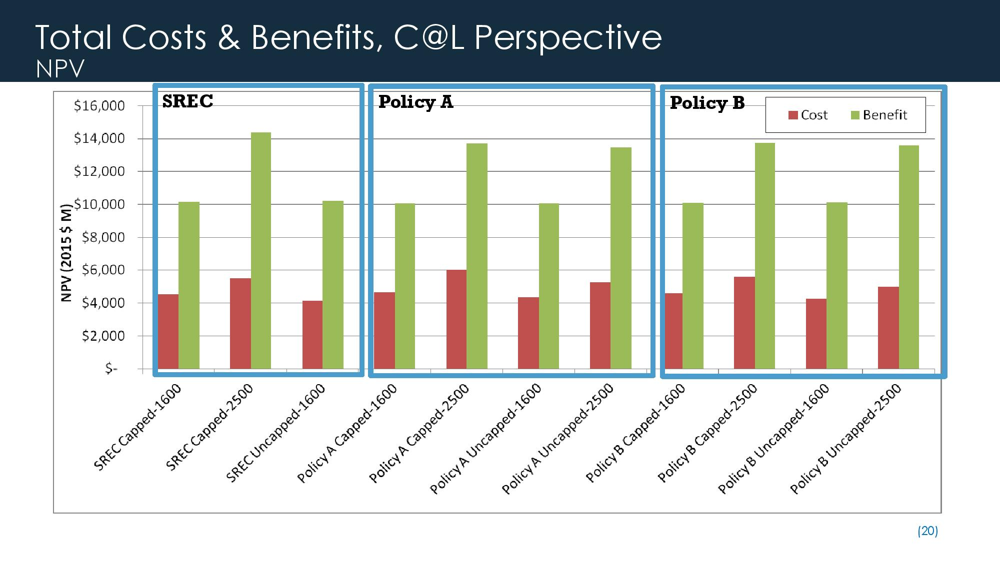
Consultant Analysis Key Takeaways
1. Benefits exceed costs. Our solar policies and incentives are delivering benefits that far exceed the total costs to consumers. (Note: C@L=Commonwealth at-large)
Notes:
Source: Consultant’s 4/27/15 presentation of Task 3 results, Slide 20, available for download at http://www.mass.gov/eea/docs/doer/renewables/analysis-of-costs-and-benefits-final-results-4-27-15.pdf

Slide 15
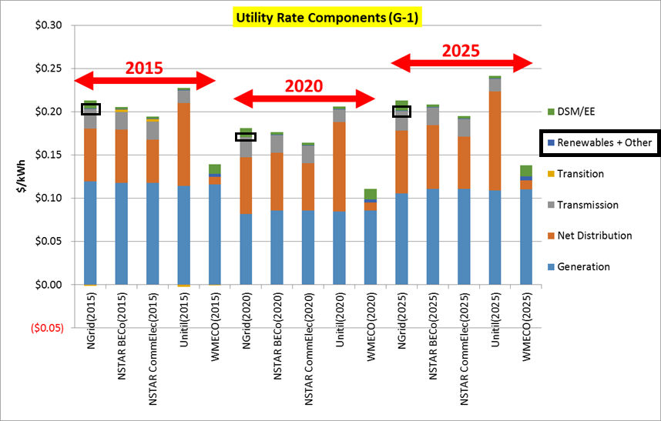
Key takeaways
2. Ratepayer impact minimal. The costs of solar and other renewable energy programs constitute a very small portion of customers’ electricity rates.

Slide 16
Key takeaways
3. Net metering caps increase costs. Modeled scenarios with no net metering caps shown to be more cost-effective way to develop solar in Massachusetts and ensure a diverse solar market.
4. Minimum bills aren’t the answer. Minimum bills have the greatest impact on lowest using, most efficient solar customers. Can also impact low income, low consumption (non-solar) users.

Slide 17
Task Force Recommendations
TF Members drafted a set of general solar principles and made a set of recommendations to the legislature
Consensus was not achieved on every point; where consensus was lacking, a vote was taken

Slide 18
Summary of General Principles
Support growth of solar to 1600 MW and beyond
Equitable access should be enabled “where reasonable”
Need for increased understanding of benefits and costs
Ratepayer costs should be minimized
Everyone should contribute their “fair share” for use of grid and SBCs
Existing projects should be grandfathered in under SREC frameworks (no agreement on grandfathering for net metering)

Slide 19
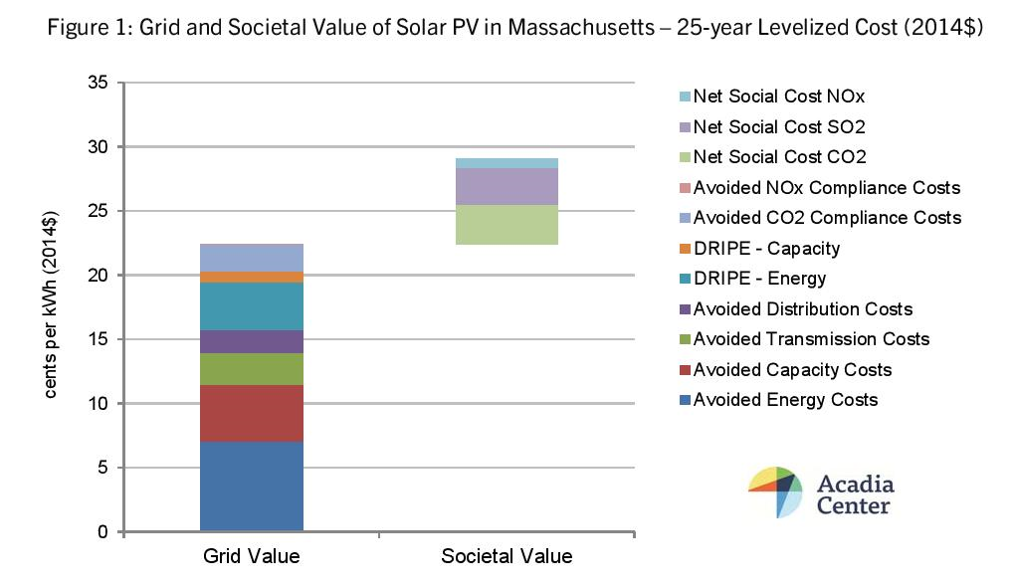
Recommendation: Value of Solar
CONSENSUS
Conduct value of solar (VOS) study
Evaluate system and societal benefits of solar
VOS study can inform compensation and incentives for solar
Value of solar in MA estimated to be at least 20-25 cents/kWh in recently released Acadia Center study.

Slide 20
Policy recommendations: Solar Incentive Program Design
CONSENSUS: New incentive framework for solar that recognizes differences b/t small, medium & large solar projects
CONSENSUS: Incentive policy for small solar should be performance based, open access & not competitive solicitations
No consensus on incentive policy for large systems
Option 1: Declining Block Incentive
Option 2: Competitive Procurement

Slide 21
Policy Recommendations: Net metering caps
No consensus
Option 1 (majority position): Raise caps a limited amount in short-term while working our long-term. Caps can be eliminated in long-term if customers receiving and paying their fair share for grid, services and products.
Option 2: Don’t raise caps until there is a long-term solution. Ability to increase or remove caps dependent on progress towards fair and full compensation for use and value provided to grid and reasonable ratepayer costs.
Supported by National Grid, Eversource and Associated Industries of Massachusetts (AIM)
Notes:
In other words, a majority of the Task Force supports taking immediate action on the caps.

Slide 22
Policy Recommendations: Net Metering Caps
No consensus
Option 1 (majority position): Solar should receive fair compensation for the value it provides to the grid through a combination of a bill credit and compensation from incentives or other sources. Value determined through value of solar study.
Option 2: (1) Solar output should be paid at QF or wholesale rates; (2) If solar provides benefits to grid that reduce utility costs, it should be compensated; (3) Societal and environmental benefits should be paid through RPS or similar mechanism; (4) Amount paid for solar services should be less costly than alternatives; (5) Ability to transfer credits should be replaced with cash payment mechanism.
Supported by Ngrid, Eversource and AIM

Slide 23
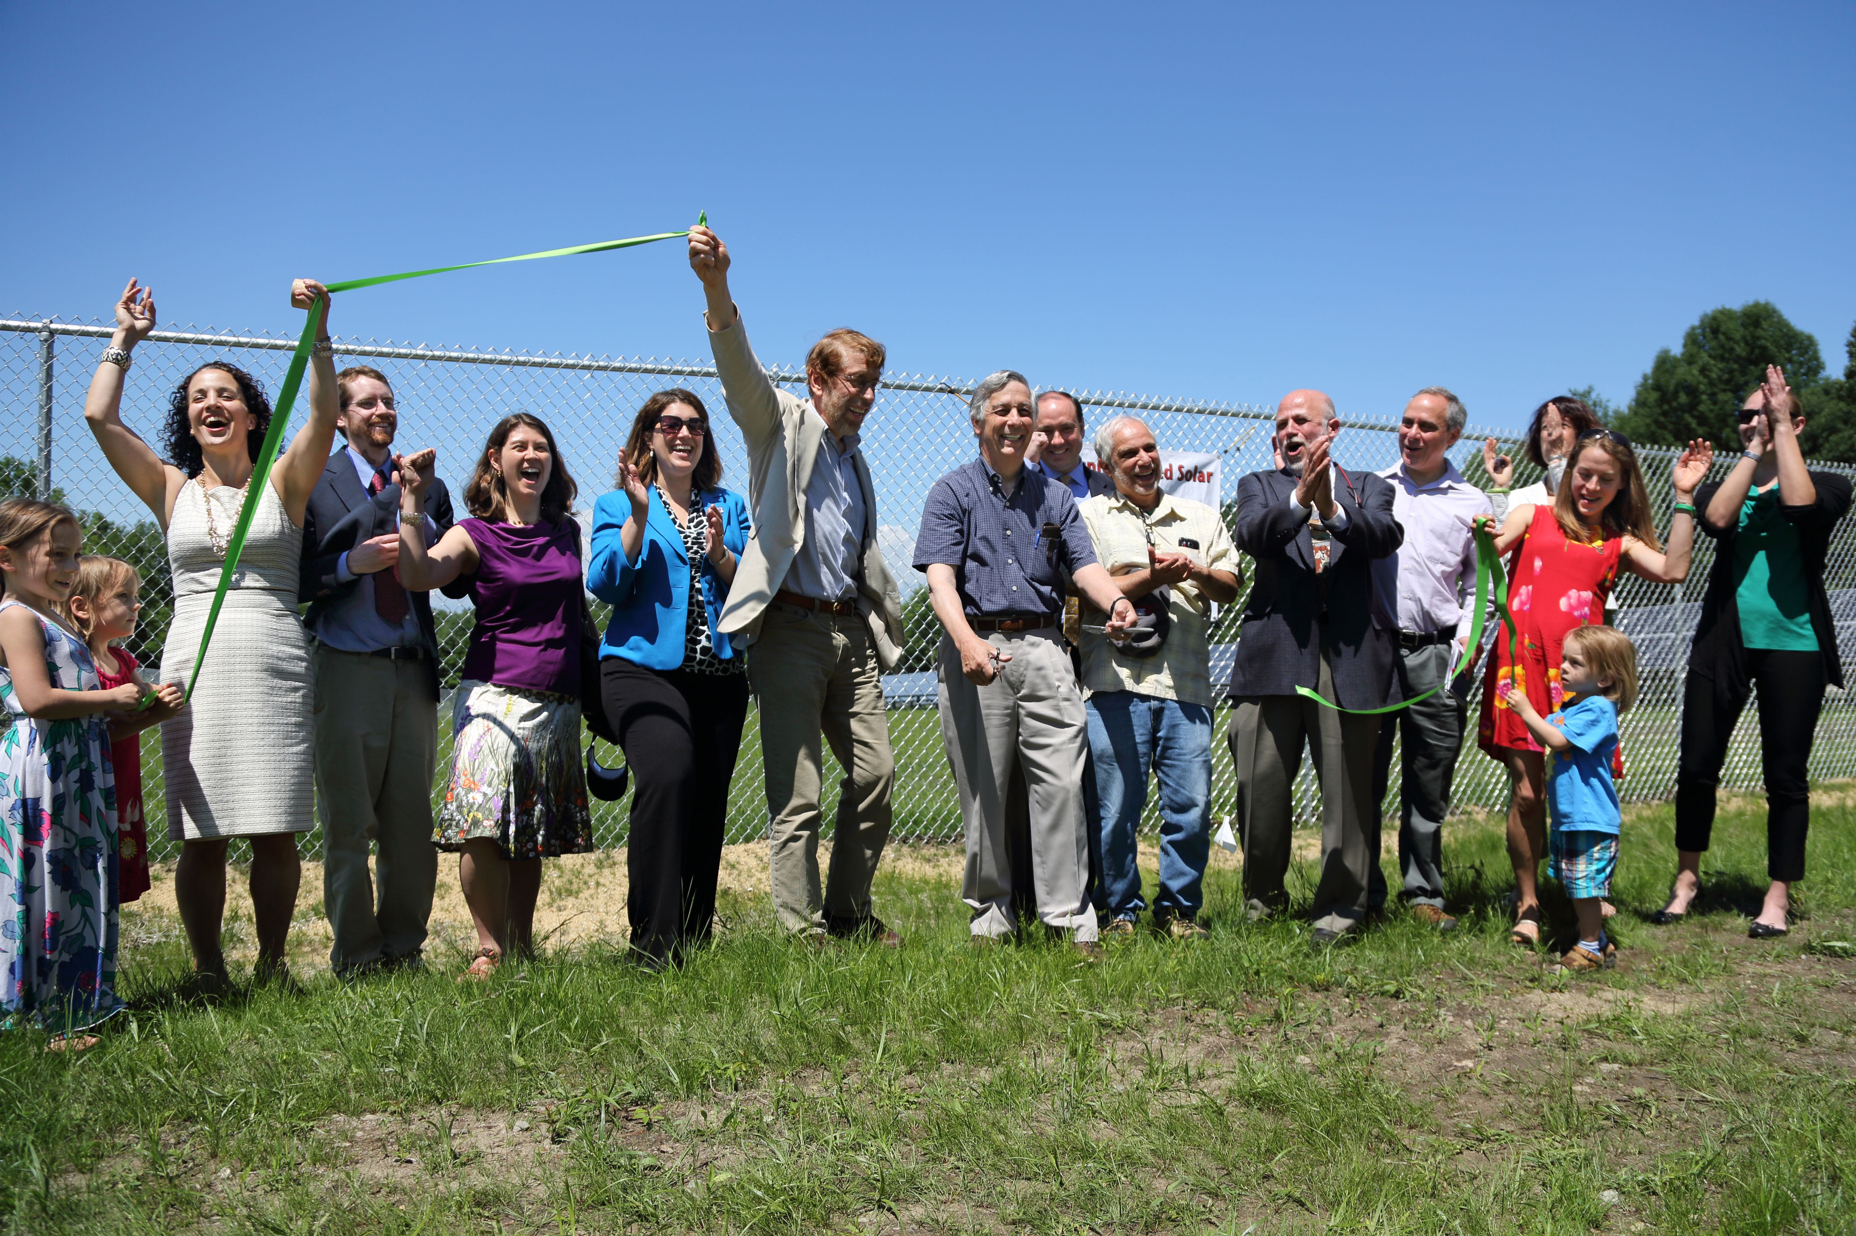
Policy Recommendations: Geographic Distribution
CONSENSUS: There should be equal opportunity for solar development across the state and equal solar compensation across the state will encourage more even geographic distribution of solar. Encouraging solar where it can provide distribution system benefits should be explored.

Slide 24
Policy Recommendations: Fair Compensation for use of Grid (aka minimum bill)
CONSENSUS: Everyone who is connected to the grid should contribute to their use of it and the SBCs. A fair compensation mechanism should apply to all customers, be cost based and set in accordance with customer’s use of grid, customer size, etc. Specifics should be determined in DPU utility-specific evidentiary proceeding.

Slide 25
Policy Recommendations: Municipal Light Plants
CONSENSUS: Legislature should explore RPS cross-subsidization as MLP’s do not pay RPS compliance costs, MLP customer access to solar; clarify that third party owned solar is allowed

Slide 26
Policy Recommendations: Miscellaneous
Although not central to scope of TF, further (brief) recommendations made on:
Permitting
Interconnection
Taxes
Each of the above represents additional ways to lower the costs of solar and ratepayer impact.

Slide 27
Task Force Report: What’s missing?
No consideration of policies or programs to ensure or expand access to solar in low income communities.
Language to reference in the report, Next Step Living’s individual statement (pg. 41):
“[G]iven the limited amount of time, the Task Force was unable to have an in-depth consideration of issues related to low income access to solar, and how solar can be leveraged to proactively address energy affordability concerns in low income communities.”

Slide 28
Beacon Hill Politics and Timeline

Slide 29
Beacon Hill politics and timeline
Governor is siding with the utilities: No cap increase w/o a long-term solution
Senate is sympathetic, wants to raise caps
House is TBD, but tends to be more utility-friendly and is (at the moment) is aligning with Baker on a lot of issues
Net metering hearings before TUE
committee likely early June

Slide 30
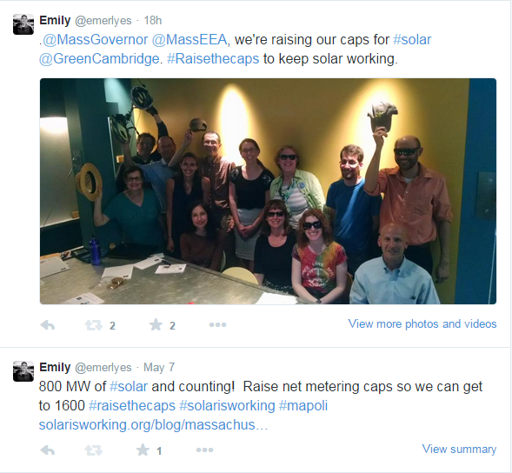
What You Can Do
Call, write, meet with and tweet at legislators, Governor and administration officials. Ask them to raise net metering caps ASAP.
Testify or submit testimony
at net metering hearing
If you have a stalled project,
contact local media to share
your story; write op-eds; LTEs
Speak publicly, in support of
raising the caps, as much as
you can

Slide 31
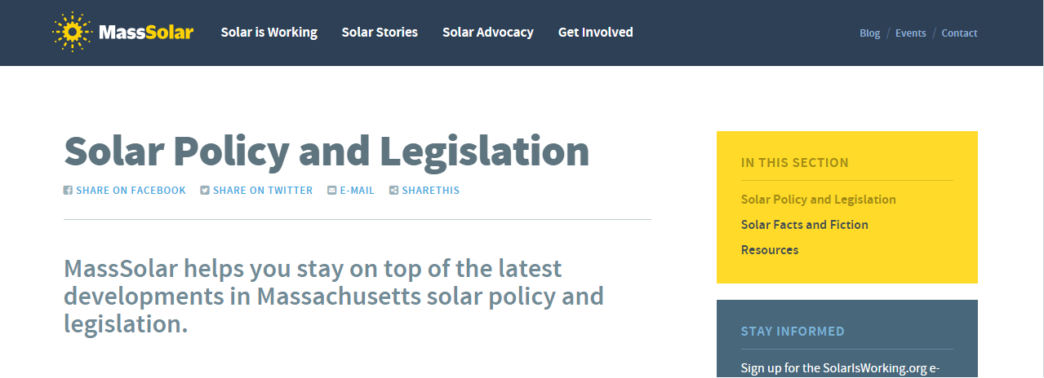
Staying informed
Stay in the loop and find resources at: www.solarisworking.org
(e-mail erochon@bostoncommunitycapital.org w/questions)

Slide 32
Questions?

Slide 33
Bonus: Responding to Utility Talking Points

Slide 34
Responding to utility talking points
What they claim: Ratepayers are paying 60 cents a kWh for solar (Eversource)
Response 1: Eversource is using an inflated figure that assumes (1) all solar systems are residential and being paid at this winter’s unprecedented residential electricity rates (i.e. 24 cents/kWh); and (2) utilities are always paying at or near the Alternative Compliance payment for SRECs (they are not). Compensation for solar varies widely across utility territories, project types and over time as electricity rates and SREC prices change. The average price we’re paying for solar is not 60 cents/kWh over the 20-25 year life of solar projects.
Response 2: The Acadia Center Value of Solar study shows that the value that solar provides is in excess of retail electricity rates, close to 35 cents per kWh.

Slide 35
Responding to utility talking points
What they say: Solar is costing ratepayers $2-4 billion over the next decade (NGrid &Eversource)
Response 1: The TF consultant analysis shows that the benefits of solar exceeds costs.
Response 2: Ratepayer impact from renewable programs is minimal, as confirmed by the TF consultant analysis.
Response 3: This winter’s natural gas electricity price increases cost ratepayers $3 billion in 3 months.
Response 4: Every dollar invested in solar yields $1.20 in economic benefits. Between 2010-2014, $2.37 billion was invested in Massachusetts thanks to our solar programs.

